Slide 1
Esophagostomy

Slide 2
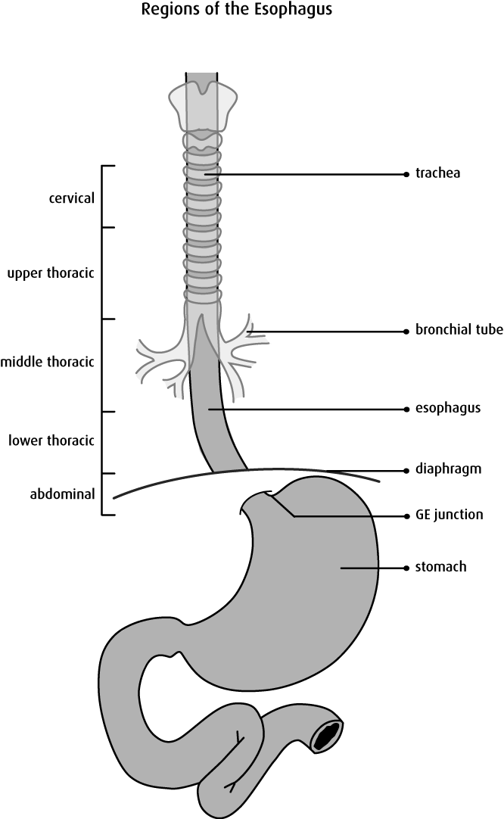
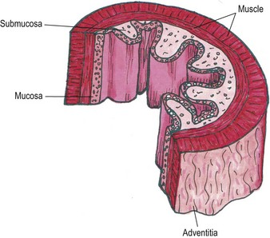
Indication
1. foreign bodies (potatoes, turnips…ect) in horses and cattle lodged in the cervical part of the esophagus…….in dogs and cats bones are lodged in the cervical and thoracic parts of the esophagus.
2. esophageal diverticula's.

Slide 3
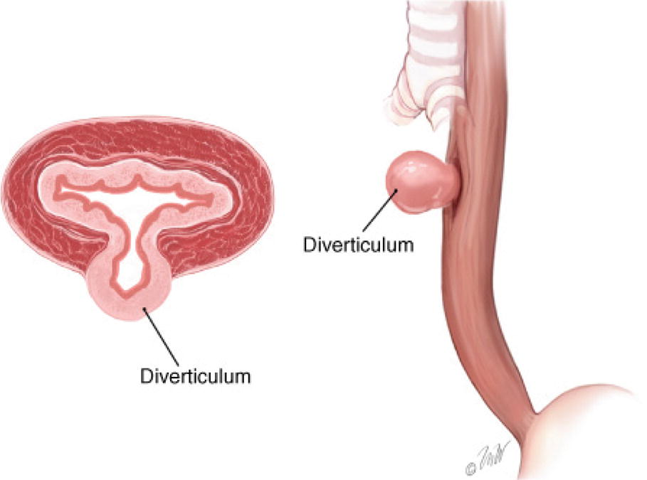
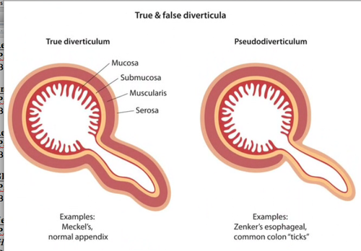

Slide 4
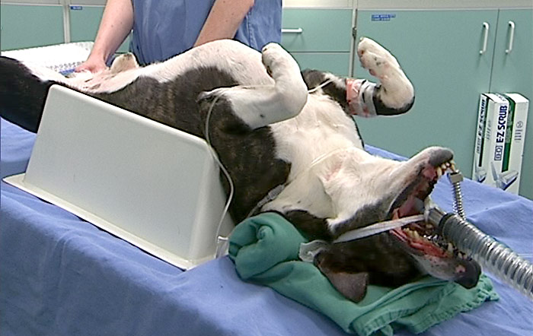
operation procedure
the operation is performed from the left side of the neck or from the site of the foreign body in recumbent position under general anesthesia

Slide 5
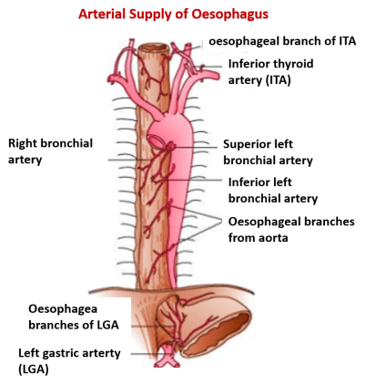
blood vessels of the esophagus
cervical portion: cranial and caudal thyroid arteries and esophageal branch of carotids
thoracic portion: bronchesophageal artery
ventral portion: left gastric artery

Slide 6
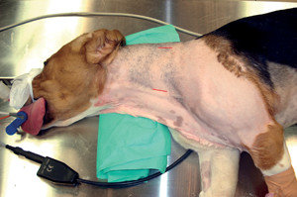
Surgical procedure
the site of operation clipped , shaved , and disinfected
10-20 cm long incision should be made longitudinally in the jugular groove
the skin incision should be made between the jugular vein and the edge of sternomandibular muscle far away from the carotid artery

Slide 7
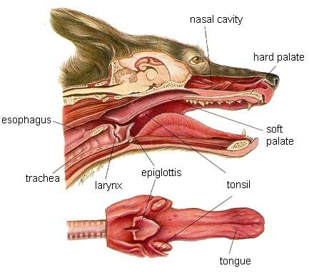
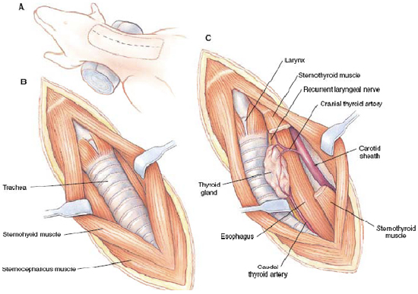
Surgical procedure
incision is continued through the cutaneous muscles and blunt dissection is used until reach to the lateral surface of the trachea
the esophagus is recognized by stomach tube , it is pale reddish color

Slide 8
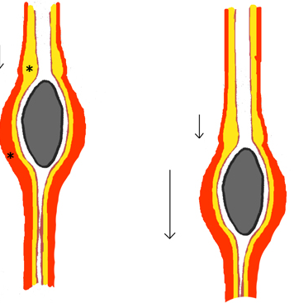
Surgical procedure
the esophagus is opened longitudinally to allow the remove of the foreign body without tearing the wall ,the foreign body is removed by rough thumb forceps

Slide 9
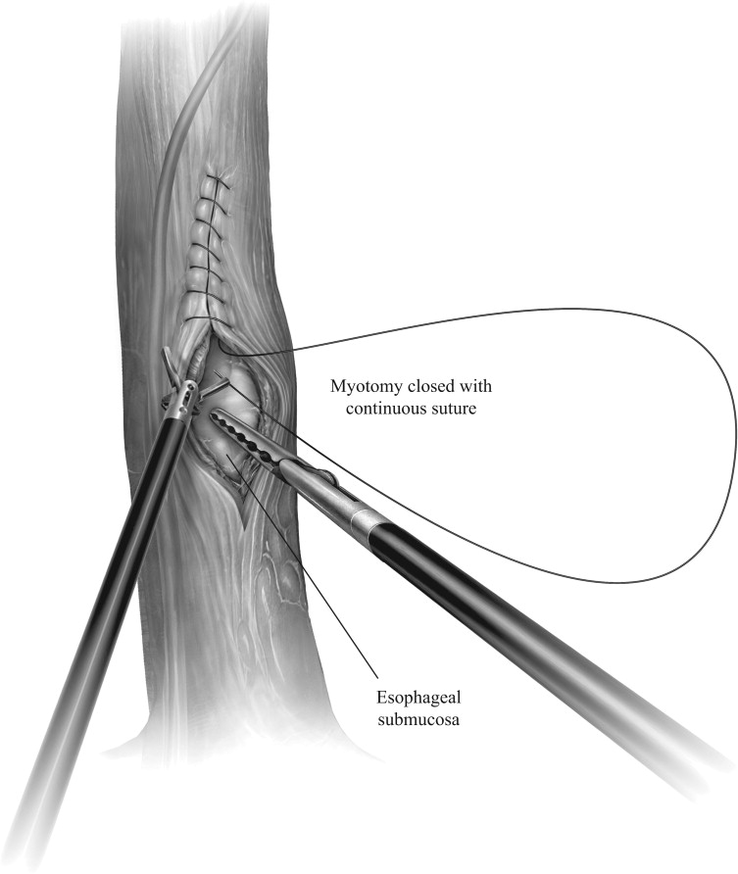
Surgical procedure
the wound of the esophageal wall is sutured as the following patterns A- mucosa is suture alone with cat gut 3-0 usp with a simple interrupted pattern and the knot should be inside the lumen. B- muscular layer of the esophagus is sutured with interrupted or continuous suture pattern with non absorbable suture material
the muscles is sutured with simple continuous pattern with catgut

Slide 10
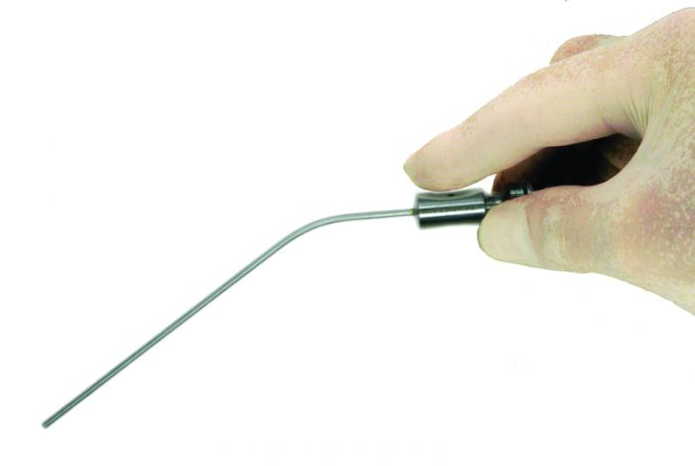
Surgical procedure
the operation area should be flushed with solution containing broad spectrum antibiotics
the skin is sutured by simple interrupted pattern

Slide 11
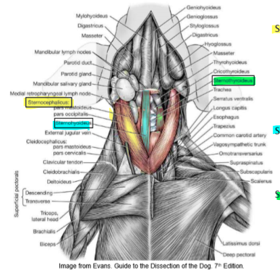
the structures you found in esophagostomy
skin
cutaneous muscles
sternomandibular muscles
jugular vein
vagus nerve
carotid artery
recurrent nerve
trachea
esophagus

Slide 12
post operative care
systemic antibiotics (penstrept): 10000-20000 IU/kg body weight for 3 days post operatively
keep the animal on fluid therapy at least 4 days and then soft fluid are given to the animal and semi sold food in the thirds week and forth week

Slide 13
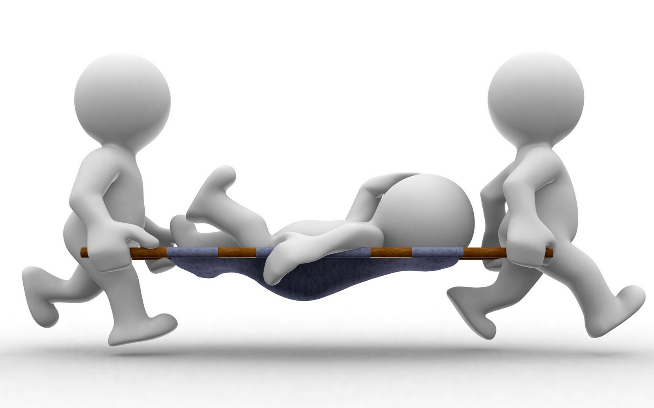
complications:
constricting scar at the site of incision
esophageal fistula
hemorrhage
infection

